Slide 1
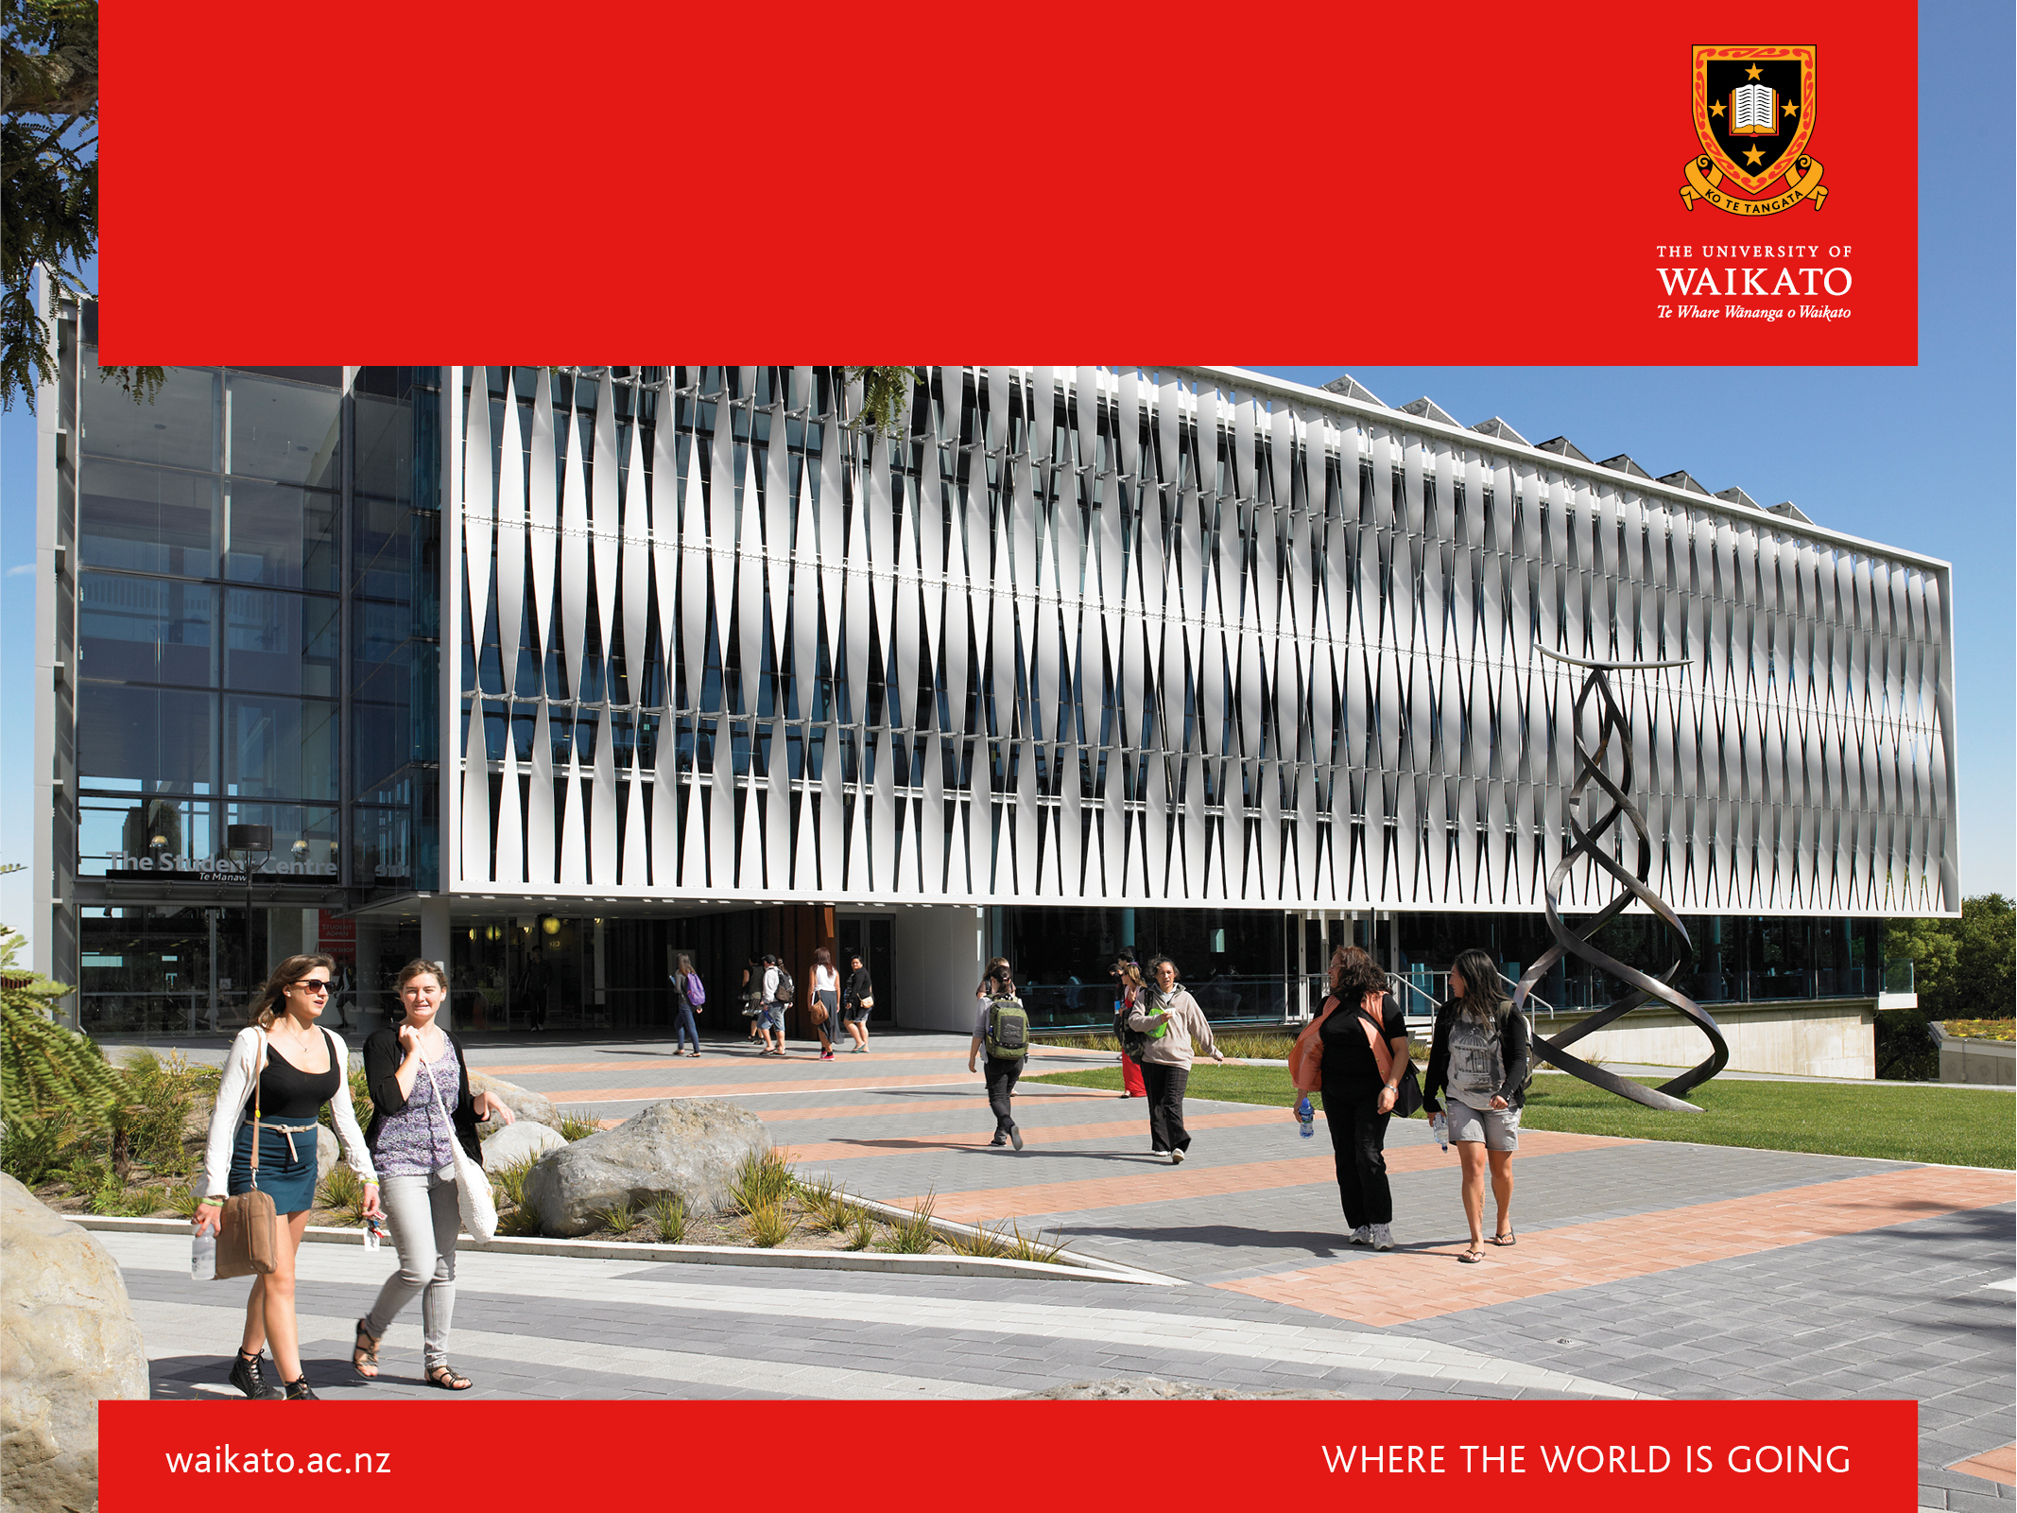
Developing a Corpus of Māori-Language Tweets
David Trye & Te Taka Keegan

Slide 2
Motivation
Social media corpora useful for developing NLP resources
Facilitate linguistic analysis of te reo Māori on social media
Promote awareness of the growing community of Māori-language tweeters
Notes:
Our Twitter corpus complements the existing body of written and spoken Māori corpora.

Slide 3
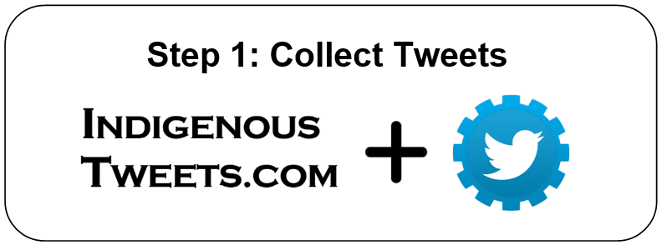
Building the RMT Corpus
Collected 11 million tweets
Notes:
Rather than reinventing the wheel, we saw an opportunity to combine existing technologies in a new way to produce a relatively high-quality corpus of Māori language tweets.

Slide 4
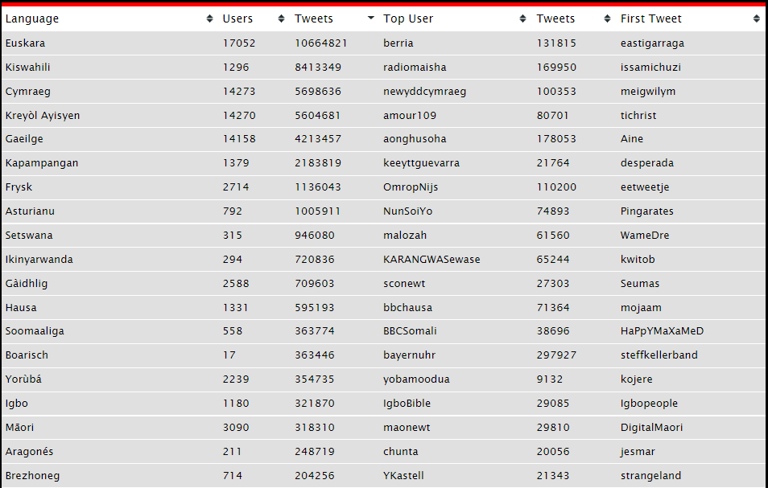
Indigenous Tweets
indigenoustweets.com

Slide 5
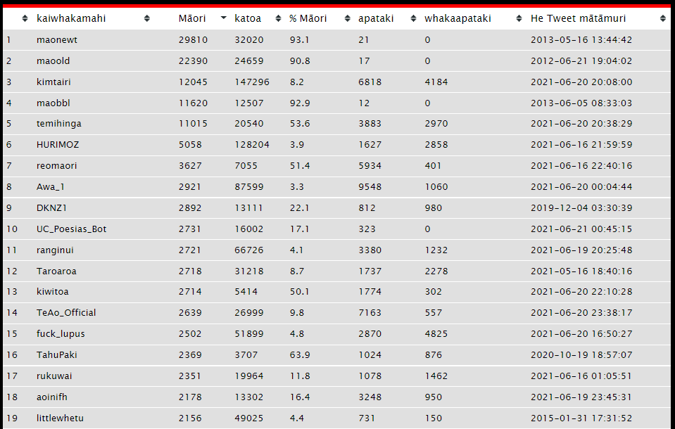
Top Māori Tweeters
indigenoustweets/mi.com

Slide 6
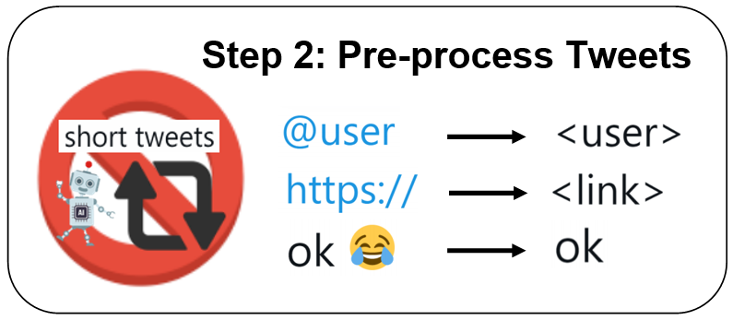
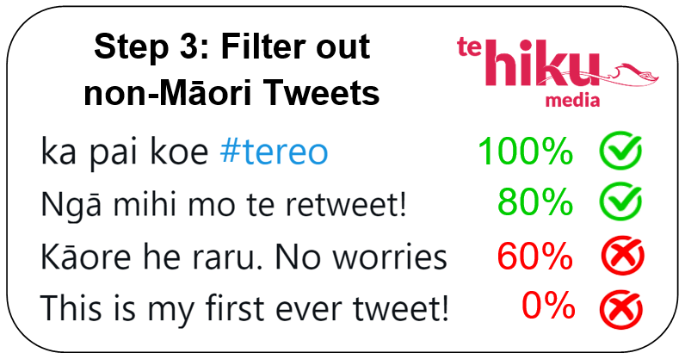
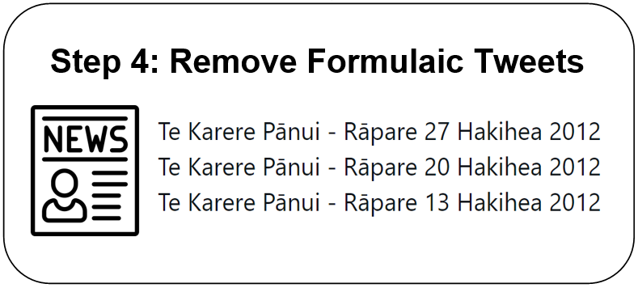
Building the RMT Corpus
Removed 1.6 million tweets (14%)
Left with ~80,000 te reo Māori tweets
Removed 4,500 tweets (0.04%)
Removed 9.4 million tweets (85%)
github.com/TeHikuMedia/nga-kupu
Notes:
We removed retweets because, for our purposes, we only cared if people had written the tweets themselves; and we didn’t particular want duplicates in the corpus, unless they were very common phrases.

Slide 7
RMT Corpus Summary
Description | Value
Number of Tweets | 79,018
Number of Tokens (Words) | 1,007,652
Number of Users (Tweeters) | 2,302
Average Tweet Length | 13 words
Average Tweets per User | 34
First (Oldest) Tweet | 25 May, 2007
Last (Most Recent) Tweet | 11 December, 2020
Time Period | ~13.5 years
This represents only a subset of Māori tweets from a subset of Māori tweeters
Rich in metadata at both the tweet and user levels
Notes:
Examples of tweet-level metadata: timestamp, Māori text (%), favourites, etc.
Examples of user-level metadata: author, gender, region, followers, etc.

Slide 8
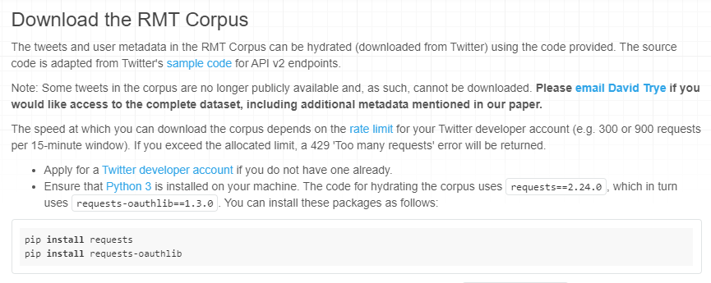
Download the RMT Corpus
kiwiwords.cms.waikato.ac.nz/rmt_corpus Search for “kiwi words waikato”
Or email: dtrye@waikato.ac.nz

Slide 9
Acknowledgements
Special thanks to:

